Slide 1
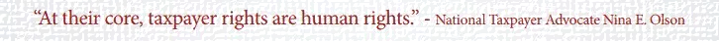
Welcome to the 2018 Temple Law Review Symposium
Taxpayer Rights in the United States:
All the Angles

